Slide 1
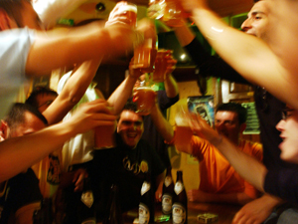
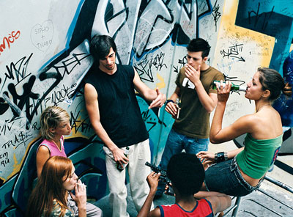
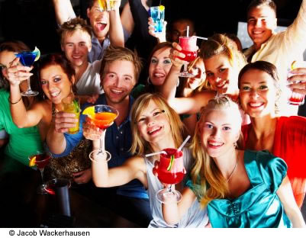
‘Have we bottled it?’ survey

Slide 2
Introduction
Objectives
Market research was required to measure attitudes to purchasing and consumption of alcohol as well as gauge attitudes to the sale and marketing of alcohol.
Methodology
An agreed questionnaire was included in Behaviour & Attitudes’ August TeleBarometer.
TeleBarometer is a nationally representative survey of 1,000 adults 16+.
Interviewing was conducted from our office in Milltown, Dublin 6.
Some of the questions relating to the consumption and purchasing of alcohol were fielded amongst an 18+ sample.
Timing
Interviewing was conducted 10th – 27th August, 2010

Slide 3
How we drink…

Slide 4
Frequency Of Drinking Alcohol Nowadays X Age All adults 18+
AGE
Total
18-20
21-24
25-34
35-49
50-64
65+
Everyday
Several days a week
Once a week
Once a fortnight
Once a month
Couple of times a year
Once a year
Less often
Never
%
%
%
%
%
%
%
Weekly+ 49% 61% 55% 45% 50% 54% 45%

Slide 5
Location Of Drinking Alcohol X Age All adults 18+
AGE
Total
18-20
21-24
25-34
35-49
50-64
65+
%
%
%
%
%
%
%
Mainly at home
Mainly out of home
Mix of both
Exclusively at home less relevant to under 25s.

Slide 6
Location Of Drinking Alcohol X Frequency Of Consumption All adults 18+
FREQUENCY OF CONSUMPTION
Everyday | Several days a week | Once a week | Once a fortnight | Once a month | Less than monthly
Total
%
%
%
%
%
%
%
Mainly at home
Mainly out of home
Mix of both
Everyday drinkers twice as likely to drink ‘mainly at home’.

Slide 7
How we think…

Slide 8
Do We Have A Drink Problem? All adults 18+
Our overall attitude towards drinking alcohol, the behaviour that goes with it, both need to change % | The current level of alcohol consumption in Ireland is a problem % | The Government is doing enough to address alcohol problems in Ireland %
Agree
Disagree
Don’t know

Slide 9
Price Of Alcohol In Ireland All adults 18+
The increase in the number of outlets selling alcohol over the past ten years has resulted in increased levels of alcohol related harm and costs | The drop in the price of alcohol in supermarkets has influenced me to buy more alcohol | If the price of alcohol were to increase by 50% I would buy less | If the price of alcohol were to increase by 30% I would buy less | If the price of alcohol were to increase by 10% I would buy less | If the price of alcohol were to decrease I would buy more
Attitudes to Alcohol Price Increases
Agree
Disagree
Don’t know

Slide 10
Average Amount Of Pocket Money Receive Per Week All 16-21 year olds
Don’t know
Less than €20
More than €60
From €20 to €30
x Age
16-17 €46.06
18-20 €59.52
21 €90.77
From €30 to €60

Slide 11
Attitudes To The Marketing And Sales Of Alcohol All adults 18+
There should be a ban on all alcohol advertising on TV and radio until after 9pm | Alcohol should not be positioned beside or behind the till in convenience stores | There should be a ban on alcohol companies advertising on or sponsoring items on social networking sites such as facebook and Bebo | There should be a minimum price on alcohol, below which alcohol cannot be sold | All outdoor advertising for alcohol brands should be banned | The government should reduce the number of outlets selling alcohol in Ireland | There should be a ban on alcohol companies sponsoring sports teams or events
Agree
Disagree
Don’t know
Mean 4/1 3.32 3.04 2.99 2.92 2.70 2.60 2.59

Slide 12
Attitudes To Parents Purchasing Alcohol For Their Teenage Children All adults 18+
It’s ok for parents to let their 15, 16 or 17 year old drink alcohol at home % | It’s ok for parents to buy alcohol for their 15, 16 or 17 year olds % | It’s ok for parents to buy alcohol for their 12, 13 or 14 year olds %
Agree
Disagree
Don’t know
Mean 4/1 1.79 1.36 1.04

Slide 13
Attitudes to alcohol amongst 16-21s

Slide 14
Ownership Of Alcohol Branded Merchandise All 16-21s
%

Slide 15
Ownership Of Alcohol Branded Merchandise X Age All 16-21s
 | TOTAL | AGE
 |  | 16-17 | 18-20 | 21
 | % | % | % | %
An item of clothing | 39 | 39 | 39 | 43
A keyring | 31 | 24 | 39 | 25
A rugby/football sports jersey | 26 | 24 | 27 | 25
A mobile phone/iPod cover or accessory | 9 | 14 | 7 | -
Any other promotional items | 32 | 29 | 36 | 29
None of these | 4 | 3 | 3 | 8

Slide 16
Favourite Advertising At The Moment All 16-21s
%
5 of their top 10 favourite ads are for alcohol.

Slide 17
Alcohol Brands Seen Advertised Recently x Age All 16-21s
 | TOTAL | AGE
 |  | 16-17 | 18-20 | 21
Base: | 226 | 83 | 108 | 35*
 | % | % | % | %
Guinness | 39 | 32 | 45 | 34
Heineken | 35 | 29 | 40 | 33
Bulmers | 32 | 33 | 32 | 31
Budweiser | 31 | 32 | 28 | 41
Smirnoff | 30 | 28 | 32 | 30
Carlsberg | 24 | 18 | 25 | 32
Coors | 11 | 9 | 14 | 7
Unspecified brand | 10 | 12 | 10 | 8
WKD/Wicked | 8 | 12 | 6 | 7
Bacardi | 5 | 1 | 8 | 7
Miller | 5 | 3 | 7 | 3
Magners | 3 | 4 | 2 | 5
Malibu | 3 | 3 | 2 | 6
Absolut | 3 | 3 | 3 | -
Corona | 3 | 5 | 2 | -
West Coast Cooler | 3 | 4 | 2 | -
Huzzar | 2 | 5 | 1 | -
Fosters | 2 | 3 | 2 | -
Carling | 2 | 4 | 1 | -
Kopperberg | 2 | 2 | 1 | 3
Have not seen/heard any | 6 | 7 | 4 | 8
* Caution low base size

Slide 18
Source Of Advertising Awareness All 16-21s
%
All other answers 1% or less
TV is invariably the most commonly cited source of advertising – regardless of brand/category.

Slide 19
Particular Likes About Advertising All 16-21s
%

Slide 20
Social Networking: Have You Seen Or Heard… All 16-21 year olds
16-17 | 18-20 | 21
% | % | %
83 | 91 | 84
64 | 51 | 50
31 | 43 | 40
20 | 29 | 18
60 | 49 | 56
- | 1 | -
%

Slide 21
Thank you

